Slide 1
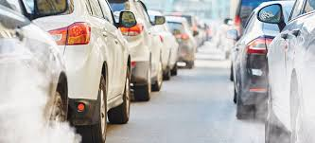
C02 Emissions
Group Members:
1. Arun Kumar a s
2. Naveen Nimmakayala
3. Pratiksha Sopan Dhamale
4. Simran Kaur

Slide 2
Content
Introduction
Project Workflow
Dataset
EDA
Feature Engineering
Model Selection
Model Building & Training
Result
Deployment
Streamlit App
Conclusion
References

Slide 3
Introduction
Carbon dioxide (CO2) is a major component of a vehicle's tailpipe emissions. Motor vehicles are estimated to contribute nearly 24% of the world's direct CO2 emissions.
CO2 emissions have significant environmental impacts.
The accumulation of CO2 in the atmosphere contributes to the greenhouse effect, trapping heat and causing global warming.
The long-term consequences of climate change can negatively impact human health, agriculture, biodiversity, and socio-economic systems.
So, in this project we develop a predictive model that establishes the relationship between various car engine features and the emissions of carbon dioxide.

Slide 4
Workflow
Data Collection
Deployment
EDA
Model Evaluation
Feature Engineering
Model Selection
Model Training

Slide 5
Dataset
In our dataset the number of variables (columns) is 12, and the number of instances (rows) is 7385.
The columns are as follows:
Make: This tells us about the car brand.
Model: This tells us about the specific model of the car.
Vehicle class: The type of body of the car e.g.: compact, truck, two seater.
Engine size: Size of the car engine, in Liters.
Cylinders: Number of cylinders. A chamber in the engine where fuel is combusted to generate power.
Transmission: It refers to the mechanical system that regulates the application of power from the engine to the wheels, allowing the vehicle to change speeds. In the dataset, "A" for 'Automatic', "AM" for ``Automated manual', "AS" for 'Automatic with select shift', "AV" for 'Continuously variable', "M" for 'Manual'.
Fuel type: The type of fuel used in different vehicles. "X" for 'Regular gasoline', "Z" for 'Premium gasoline', "D" for 'Diesel', "E" for 'Ethanol (E85)', "N" for 'Natural gas'.
Fuel_consumption_city: City fuel consumption ratings, in litres per 100 kilometres.
Fuel_consumption_hwy: Highway fuel consumption ratings, in litres per 100 kilometres.
Fuel_consumption_comb(l/100km): The combined fuel consumption rating (55% city, 45% highway), in L/100 km.
Fuel_consumption_comb(mpg): The combined fuel consumption rating (55% city, 45% highway), in miles per gallon (mpg).
Co2_emissions: The tailpipe emissions of carbon dioxide for combined city and highway driving, in grams per kilometres.

Slide 6
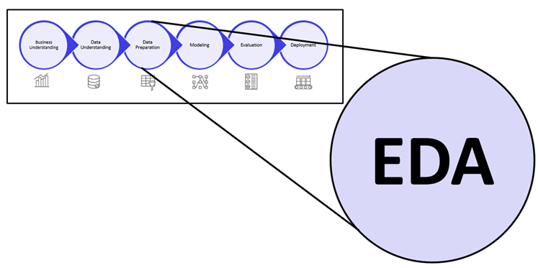
EDA
Exploratory Data Analysis (EDA) refers to the method of studying and exploring record sets to apprehend their predominant traits, discover patterns, locate outliers, and identify relationships between variables.
EDA is normally carried out as a preliminary step before undertaking extra formal statistical analyses or modeling.

Slide 7
EDA Process
Data Collection
Data Cleaning
Handling Missing Data
Outlier Detection
Identify Correlated Variables
Visualizing and Analysing

Slide 8
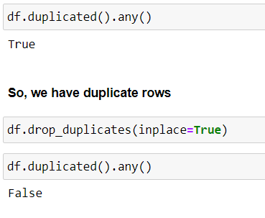
Data Cleaning
Data cleaning is the process of fixing or removing incorrect, corrupted, incorrectly formatted, duplicate, or incomplete data within a dataset.
When combining multiple data sources, there are many opportunities for data to be duplicated or mislabeled.
If data is incorrect, outcomes and algorithms are unreliable, even though they may look correct.

Slide 9
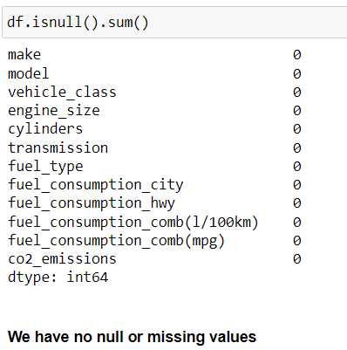
Handling Missing Data
You can’t ignore missing data because many algorithms will not accept missing values. There are a couple of ways to deal with missing data. Neither is optimal, but both can be considered.
As a first option, you can drop observations that have missing values, but doing this will drop or lose information, so be mindful of this before you remove it.
As a second option, you can input missing values based on other observations; again, there is an opportunity to lose integrity of the data because you may be operating from assumptions and not actual observations.
As a third option, you might alter the way the data is used to effectively navigate null values.

Slide 10
Outlier Detection
Outliers are those data points that are significantly different from the rest of the dataset. They are often abnormal observations that skew the data distribution, and arise due to inconsistent data entry, or erroneous observations.
To ensure that the trained model generalizes well to the valid range of test inputs, it’s important to detect and remove outliers.
For numerical data, we are using Interquartile Range (IQR) Method:
IQR = Q3 – Q1
lower limit = Q1 − (1.5×IQR)
upper limit = Q3 + (1.5×IQR)
We can either remove the outliers or cap them.
Capping, in the context of data analysis and statistics, refers to limiting or setting a threshold on extreme values (outliers) in a dataset. Capping is often done to mitigate the impact of outliers on the analysis, modeling, or visualization of data.
Outliers are not as easily defined for categorical data as they are for numerical data. However, we can consider the following technique:
Frequency-Based Approach: Identify categories with very low frequencies. Categories that are rare might be considered as potential outliers.

Slide 11
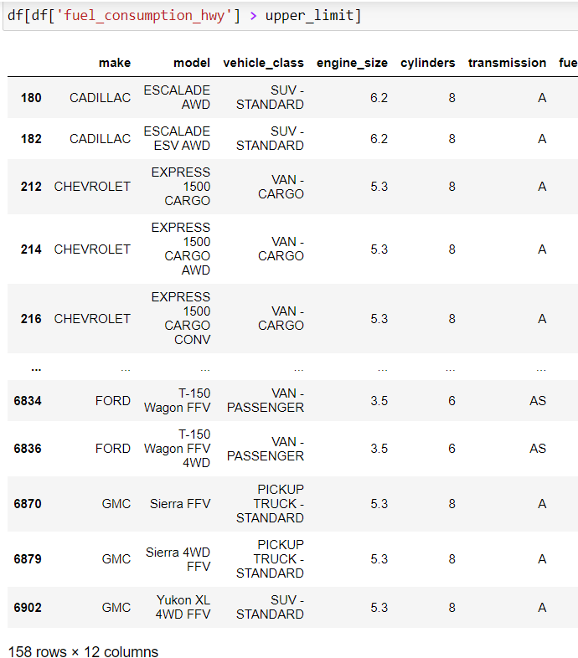
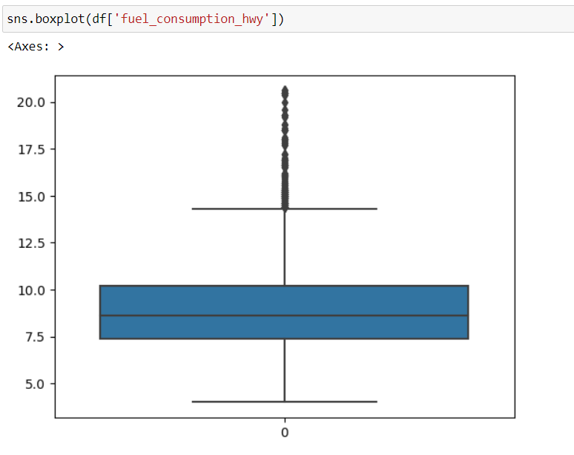

Slide 12
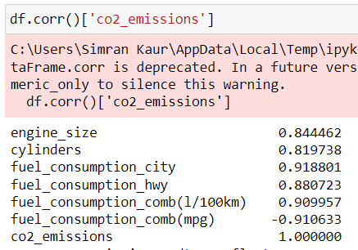
Identify Correlated Variables
A correlation is a statistical measure of the relationship between two variables. The measure is best used in variables that demonstrate a linear relationship between each other.

Slide 13
Multicollinearity
Multicollinearity is a statistical phenomenon that occurs when two or more independent variables in a regression model are highly correlated with each other.
Multicollinearity can lead to unstable and unreliable coefficient estimates, making it harder to interpret the results and draw meaningful conclusions from the model.
It is essential to detect and address multicollinearity to ensure the validity and robustness of regression models.
Multicollinearity can be detected using heatmap, corr() or vif.
VIF determines the strength of the correlation between the independent variables. It is predicted by taking a variable and regressing it against every other variable.
The higher the value of VIF and the higher the multicollinearity with the particular independent variable.

Slide 14
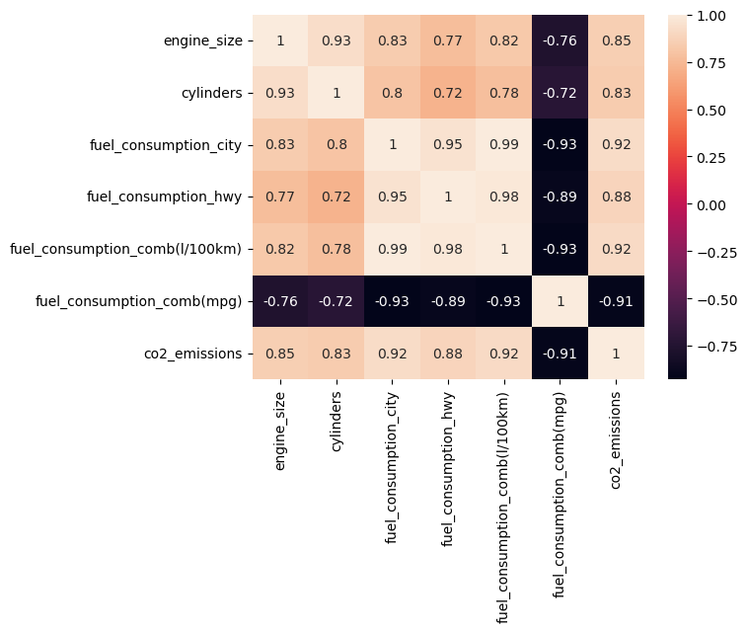
Example of Multicollinearity is : Heatmap

Slide 15
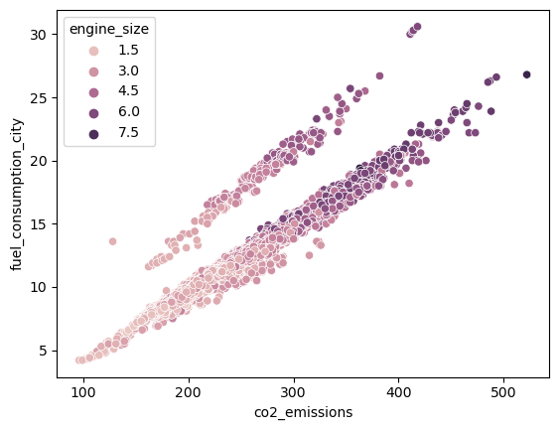
Data Visualization
Example of Data Visualization : Bubble chart

Slide 16
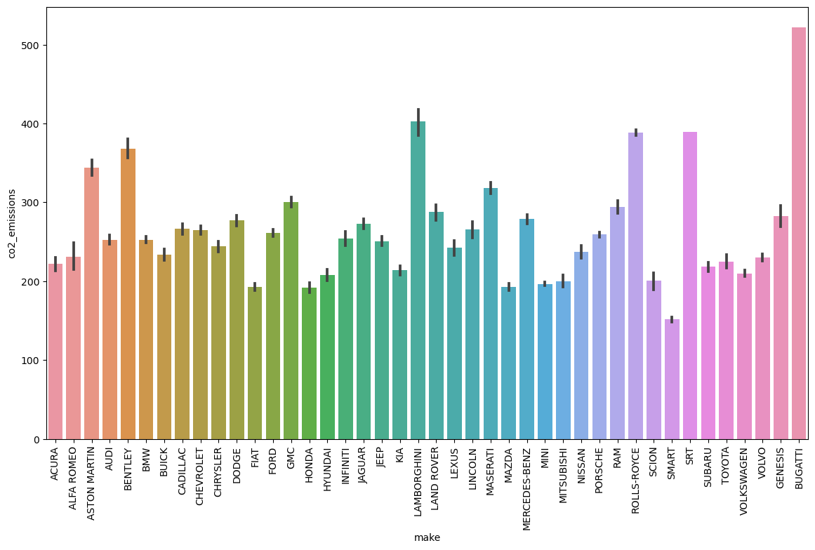
Example of Data Visualization : Barchart

Slide 17
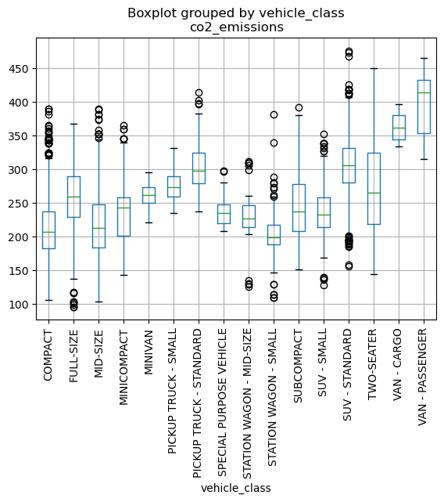
Example of Data Visualization : Boxplot

Slide 18
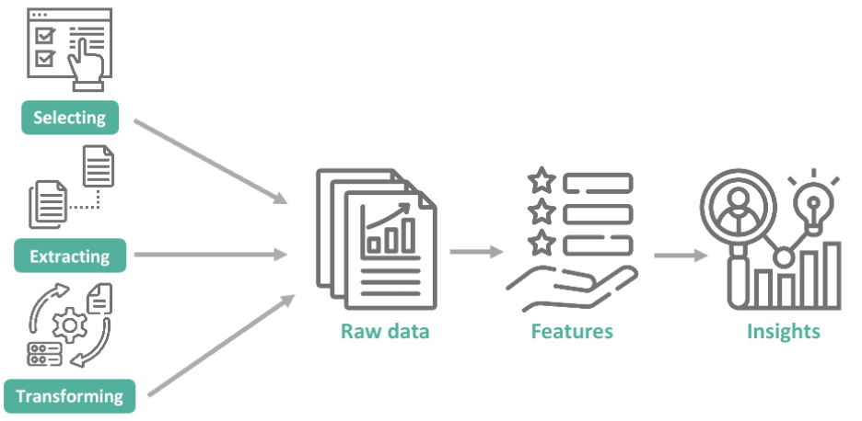
Feature Engineering
Feature engineering refers to manipulation — addition, deletion, combination, mutation — of the data set to improve machine learning model training, leading to better performance and greater accuracy.
Effective feature engineering is based on sound knowledge of the business problem and the available data sources.

Slide 19
Scaling and normalization means adjusting the range and center of data to ease learning and improve the interpretation of the results.
Feature selection means removing features because they are unimportant, redundant, or outright counterproductive to learning. Sometimes you simply have too many features and need fewer.
Feature coding involves choosing a set of symbolic values to represent different categories. Concepts can be captured with a single column that comprises multiple values, or they can be captured with multiple columns, each of which represents a single value and has a true or false in each field. For example, feature coding can indicate whether a particular row of data was collected on a holiday. This is a form of feature construction.
Feature extraction means moving from low-level features that are unsuitable for learning — practically speaking, you get poor testing results — to higher-level features that are useful for learning. Often feature extraction is valuable when you have specific data formats — like images or text — that have to be converted to a tabular row-column, example-feature format.

Slide 20
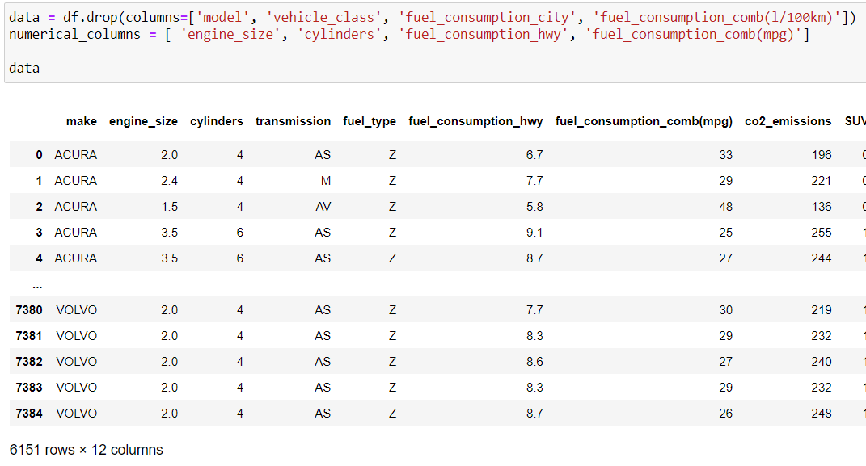
Example of Feature Engineering is :

Slide 21
Model Selection
Model selection is the process of selecting the best model from all the available models for a particular business problem on the basis of different criterions such as robustness and model complexity.
We have trained and evaluated our dataset with the given model:
- Linear Regression
- Ridge Regression
- Lasso Regression
- KNN
- Support Vector Machines (SVM)
- Random Forest

Slide 22
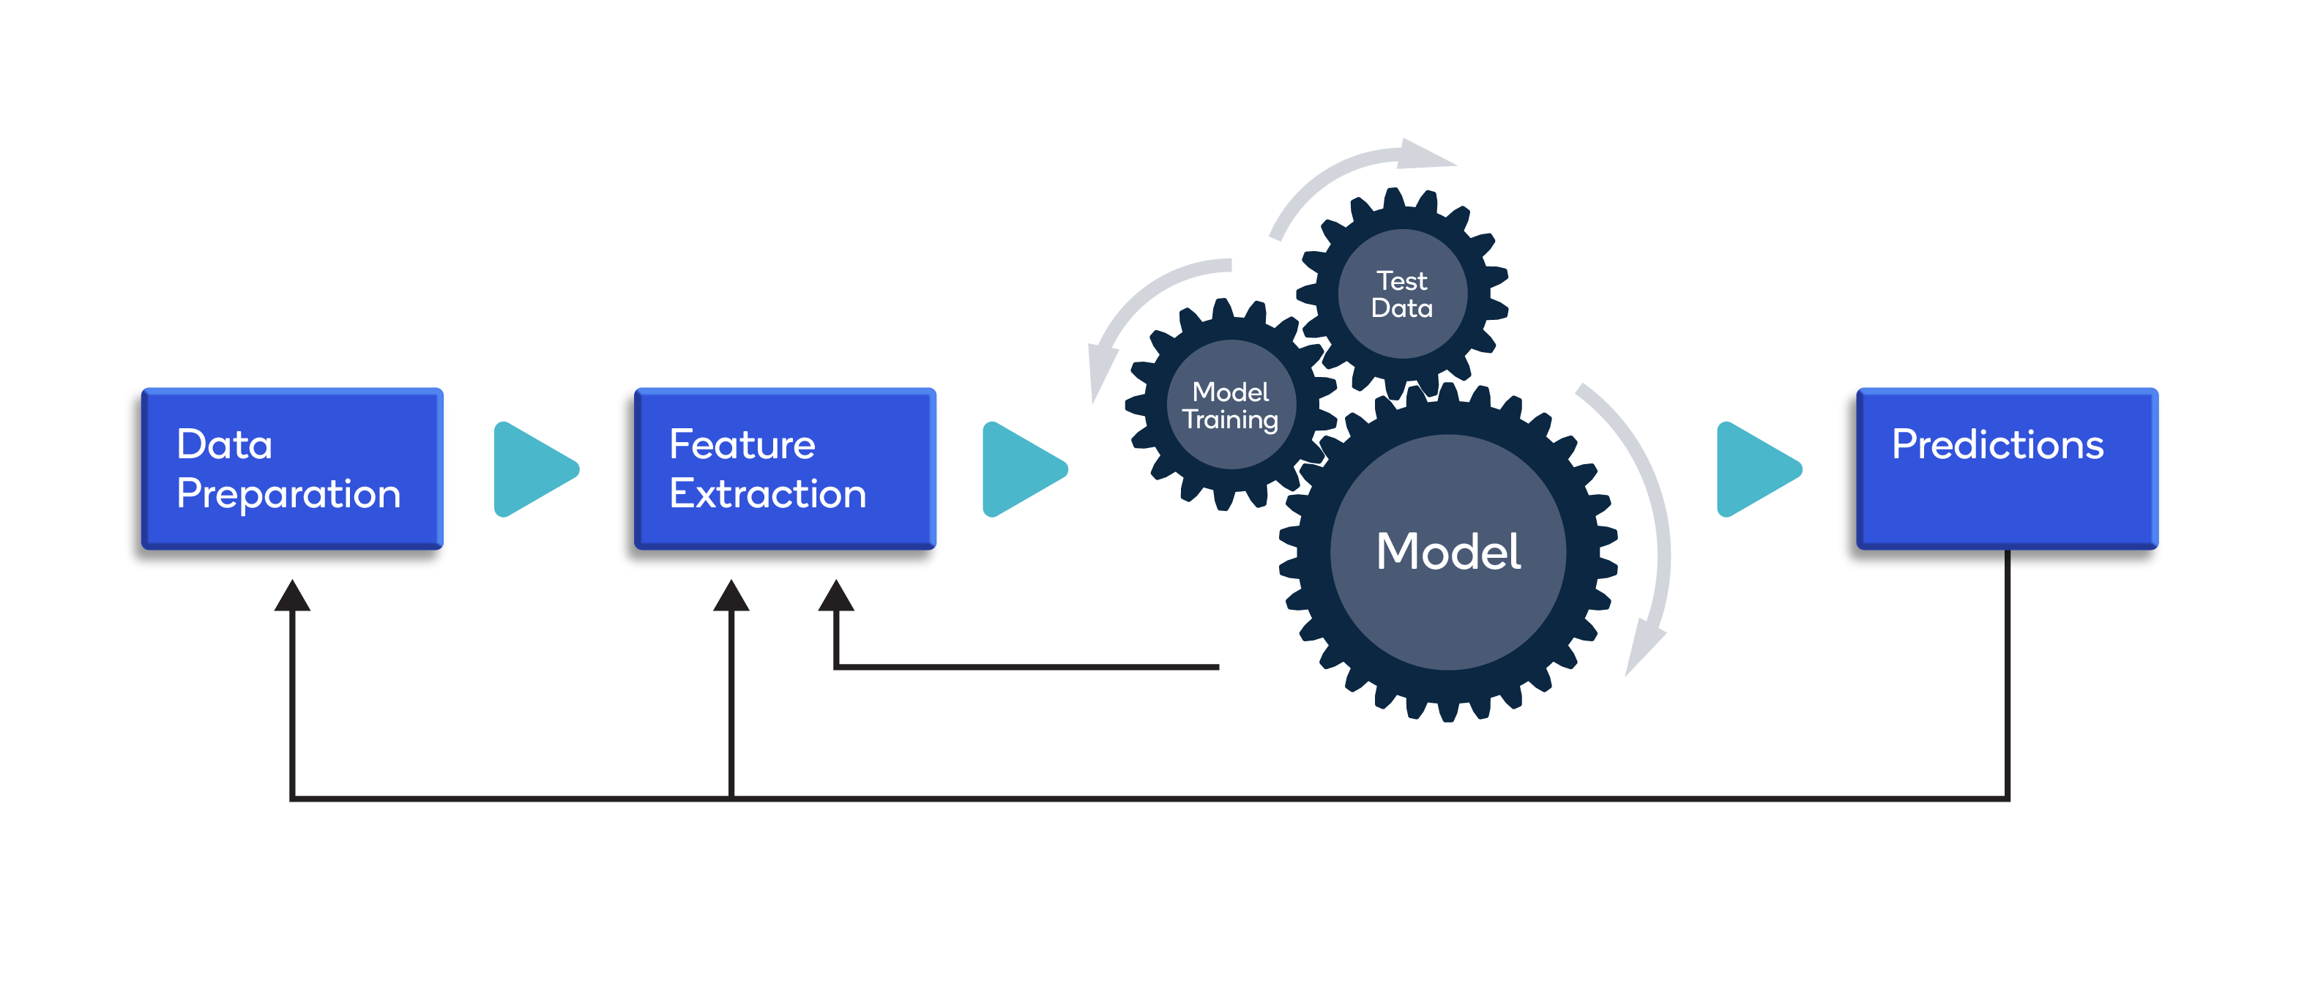
Model Building and Training
A training model is a dataset that is used to train an ML algorithm. It consists of the sample output data and the corresponding sets of input data that have an influence on the output. The training model is used to run the input data through the algorithm to correlate the processed output against the sample output. The result from this correlation is used to modify the model.
This iterative process is called “model fitting”. The accuracy of the training dataset or the validation dataset is critical for the precision of the model.
Model training in machine language is the process of feeding an ML algorithm with data to help identify and learn good values for all attributes involved. There are several types of machine learning models, of which the most common ones are supervised and unsupervised learning.

Slide 23
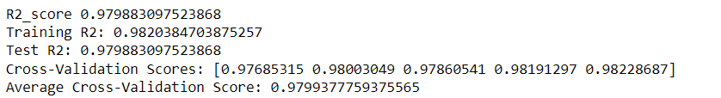
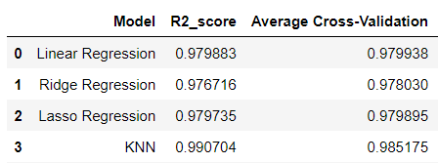
Result
The r2 score for the models is very close so, we are going to use linear regression as our model for simplicity.

Slide 24
Deployment
Deploying a machine learning model involves making the model available for use in a real-world environment, where it can generate predictions or classifications on new, unseen data.
The deployment process includes various steps to ensure the model is integrated into the production environment effectively.
Integration of Machine Learning Model into an existing production environment where the user can enter the input to generate output & later it can used in making business decisions.
In Python , we can achieve the same by using different frameworks
Django
Flask
Streamlit
Rshiny is another powerful extension based on R to build interactive dashboards
Streamlit is a popular Python library that allows you to create web applications for machine learning models with minimal effort.
URL for the deployment- https://co2emissions-x79efojlybch6mnpxgj7uc.streamlit.app/

Slide 25
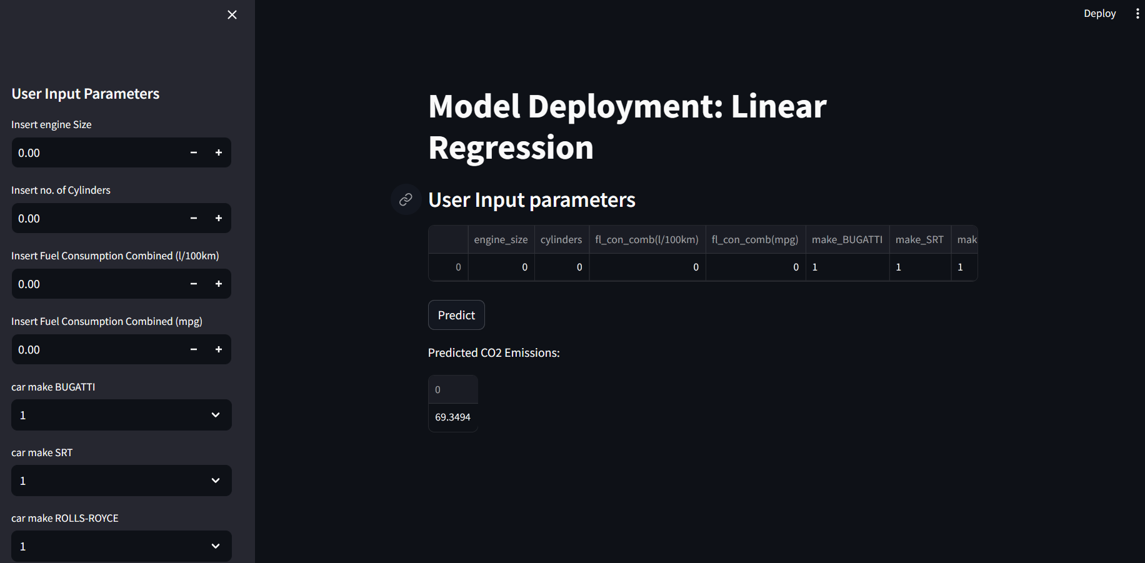

Slide 26
Conclusion
By doing data pre-processing, we can convert the original data into clean and understandable data.
Linear Regression is a good model for prediction.
Linear Regression is found to be the most accurate to the CO2 emission by vehicles.

Slide 27
Thank You !!!

